Slide 1

Repetition Structure III
Nested loops
Notes:
Welcome back everyone! After our previous lessons, you are now familiar with both while loops and for loops. Today, we will wrap up our discussion on loops by talking firstly about when you should use a while loop and when you should use a for loop. In some cases, either type of loop will work, but there are instances where one is much more suitable than the other. We will then mix things up by considering what happens when you have a loop within a loop, which is known as a nested loop. It’s loop-ception.

Slide 2
Objectives
At the end of this lesson, you will be able to….
Understand when to use a while loop compared to a for loop
Use a loop within a loop (nested loops)
Notes:
So the first part of our lesson is a bit of a summary of what we learned in the past two weeks. Even though we did talk about the situations where a while loop and a for loop are appropriate when we covered them initially, today we will compare and contrast them directly. After that, we will dive into the wonderful world of nested loops, which are really not as complicated as it might first appear. Trust me.

Slide 3
while or for loop?
Notes:
OK, so you have a problem that you need to solve using a loop. You have learned both the while loop and the for loop, so which one should you use? Let’s see if we can figure out some guidelines on which type of loop you should choose.

Slide 4
Recall: while Loop
Checks the condition
If the condition is true, executes the block of statements in the loop
Repeat from step 1 until condition is false
False
condition
while condition:
statement
statement
True
block of statements
Notes:
You’ve seen this slide before. Recall that the first thing a while loop does is check the condition, and it will keep executing the statements as long as the condition is true.
There are two implications to this. Firstly, it is possible that the statements will never be executed if the condition starts out False.
Secondly, if the condition starts out True, something must happen within the block of statements to eventually make the condition False, otherwise we will get an infinite loop.

Slide 5
Recall: for Loop
Retrieve item from list or number from range sequence
Executes the block of statements in the loop if there is item or number
Repeat from step 1 until all items in the list or numbers in range sequence have been iterated
False
Next item
True
block of statements
for item in list:
statement
statement
Notes:
You have also seen this slide before. For the for loop, Python will traverse each item in a list in order, and execute the block of statements each time. It will only stop the loop when it runs out of items in the list.
What this means is that if you know how many items there are in the list, this is the exact number of times the for loop will execute. Well, not really, you can exit the loop early with a break statement, but other than that you know the exact number of iterations. Also, because the list must contain a finite number of items, we know that in normal circumstances, a for loop will always terminate and you can never get an infinite for loop.

Slide 6
while or for loop?
Any for loop can be written as a while loop
Use a for loop if:
You wish to iterate through a specific list, processing each item exactly once in order
The number of iterations is known beforehand (you iterate through a list created using range())
Use a while loop if:
The number of iterations is not known beforehand (you will check a sentinel value)
Notes:
The fact is, any for loop can be written as while loop. All you have to do is set a counter value to zero, and then use the square bracket operator to access each item in the list using the counter, incrementing the counter by one each time. However, the reverse is not True – there is no convenient way to implement a loop that checks for the truth of a condition using a for loop, which is what a while loop does.
If all for loops can be implemented as while loops, why did Python bother to provide the for loop? It’s because for loops are much more convenient in two very common cases. The first case is if you wish to iterate through a specific list in order, and you want to make sure that you process each item exactly once. In this case, the for loop format is much easier and a lot less clumsy than manually accessing each item with an index and incrementing it each time.
The second case is when you know how many times you want to execute a loop, so you use the for loop to iterate through the list created by the range() function.
Otherwise, the while loop is the best choice. In some cases, when you don’t know the number of iterations or are not processing a list, it’s the only choice.

Slide 7
Nested Loops
Notes:
Right, now let’s see what happens when we have loops within loops. After all, a loop will execute whatever is in its loop body, and what is in the loop body could be another loop. What madness is this? Let’s see.

Slide 8
Nested Loop
If a loop contains another loop, it is known as a nested loop.
loop within a loop
for every iteration of the outer loop, the inner loop is executed
Notes:
Ok, so if a loop contains another loop within its loop body, this is known as a nested loop. How this works is that for every iteration of the outer loop, the inner loop is executed. The easiest way to understand what I mean is to take a look at an example, so let’s do that.

Slide 9
Nested Loop – Example 1
Write a nested loop to display the following pattern
* * * * *
* * * * *
* * * * *
for row in range(3):
for column in range(5):
print("*", end= " ")
print()
Note: As seen in example in Lecture 6 (while loop), you can also replace the inner loop with just one statement: print("* " * 5)
Outer loop
Inner loop
Notes:
Suppose we want to write a program to display this 3 by 5 pattern of stars – that’s 3 rows, 5 columns, so we have to print 5 stars in a line, and do this 3 times.
To do this using a nested loop, we will have an outer loop that is executed 3 times, corresponding to the 3 rows. For each of the 3 rows, we need to print 5 stars, so we will need another loop that prints a single star and a space 5 times, like this. This is the inner loop. Each time we finish printing the 5 stars, we need a single print statement to get to the next line, so this is our final program.
Take a bit of time to figure out how this program works, and trace through it step by step if necessary.
And honestly, that’s all there is to nested loops. If you are able to understand the basic concept, it is just a matter of applying it consistently when you program.

Slide 10
Nested Loop – Example 2
Given a nested list that stores some students’ names and scores for 3 tests as follows:
students = [ ['Aaron', 78, 72, 70], ['Bob', 83, 88, 50], ['Cat', 65, 90, 56] ]
Write a nested loop to display the names, test scores and average for the 3 tests.
Name Test 1 Test 2 Test 3 Average
Aaron 78 72 70 73.33
Bob 83 88 50 73.67
Cat 65 90 56 70.33

Slide 11
Nested Loop – Example 2 Solution
students = [ ['Aaron', 78, 72, 70], ['Bob', 83, 88, 50], ['Cat', 65, 90, 56] ]
print( '{:8} {:>7} {:>7} {:>7} {:>8}'.
format('Name’, 'Test 1’, 'Test 2’, 'Test 3’, 'Average’) )
for s in range( len(students) ): #outer loop for each student
print( '{:8} '.format(students[s][0]),end='' )
total = 0
for t in range(1,4): #inner loop for each test
total += students[s][t]
print( '{:7} '.format(students[s][t]),end='' )
average = total / 3
print( '{:8.2f}'.format(average) )

Slide 12
Nested Loop
We can create a nested loop using either repetition structure (while or for)
We can even use different types of loops for the inner and outer loops
We can even have nested loops within nested loops
We can even have nested loops within nested loops within nested loops within nested loops…(mind blown)
Notes:
Nested loops can be created using while loops or for loops. We can even mix and match, so we could have while loops in for loops, or for loops in while loops.
And yes, it is perfectly legal to have a loop in the loop body of an inner loop, so that you end up with a nested loop in a nested loop. There is actually no limit to the number of loops you can have within loops, until your code looks like a Russian nesting doll created by some mad scientist.

Slide 13
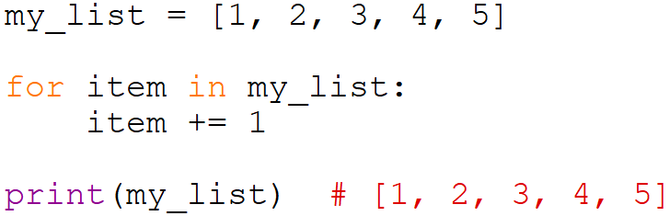
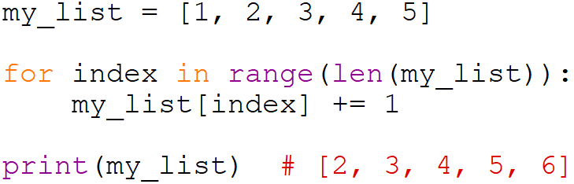
Changing List Values During Traversal
If you use a for loop to traverse a list, you cannot change the values in the list directly in this way
Instead, you should do this:
Notes:
One final note. When you use a for loop to traverse a list, the variable that takes the value of each item in the list is a separate copy, not the item itself. So for example, suppose you want to increase all values in a list by one. If you run this code that adds one to item in each iteration, you will see that nothing happens to the list itself because item is a copy.
So how would you actually solve this problem? In this case, you would need to use the square bracket operator to access the items in the list, so one method is to traverse a list of integers created by range, and the number of elements is given by len(list). In this way, you can use the square bracket operator to access the list item, and make your necessary modifications.

Slide 14
Summary
A for loop can be used to iterate through a list of items, or if number of iterations is known beforehand
while loop needs to be used if the number of iterations is not known
A loop can be nested inside another loop, also known as a nested loop
In a nested loop, for each pass through the outer loop, you execute the inner loop
Notes:
OK, that’s it, you’ve learned everything necessary to use loops. You now know how to use a for loop to iterate through a list or to run a loop a fixed number of times using the range() function, and to use a while loop to execute statements as long as a condition is True. You have also seen how you could have a loop within another loop, known as a nested loop. Python treats inner loops just like any other loop body, so it will finish executing the inner loop for each iteration of the outer loop.

Slide 15
Activity Break!
Lecture activities are in a separate file (Word document)
You are required to submit your solution for the activities in POLITEMall when you have completed all of them
Try to work on the activities now…
Notes:
Music from https://www.fiftysounds.com/royalty-free-music/marseille.html

Slide 16
Reading Reference
Python 3.7.x Documentation
https://docs.python.org/3/tutorial/controlflow.html
Learn Python Tutorial
https://www.learnpython.org/en/Loops
Notes:
The basics of loops and nested loops are not difficult, but it can get confusing in practice. You can learn more about nested loops by following these links, but the best way to learn is probably just to keep practicing. But don’t continue coding infinitely – remember to take a break if you have been coding for a while.

